Slide 1
Computer Architecture and Organization

Slide 2
Memory Interleaving

Slide 3
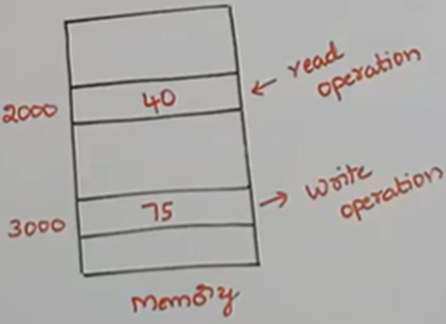
Memory Interleaving : Introduction
Interleaved memory is technique designed to compensate for the relatively slow speed of dynamic random-access memory (DRAM) or core memory by spreading memory addresses evenly across memory banks.
Assume there are two memory regions in that MM. 2000 is the first, while 3000 is the second.
Now, carry out two operations:
a read operation on memory location 2000 and
a write operation on memory location 3000.
Yet in this case, both procedures cannot be completed simultaneously.
While doing either of these two processes, we must first finish the first one before moving on to the second.
Due to the fact that this MM only has one memory and only accepts read or write requests. It is not possible to accept both requests at once. This is the limitation here.
This the main memory (MM).
Memory interleaving is a concept that we are utilizing to overcome this limitation.

Slide 4
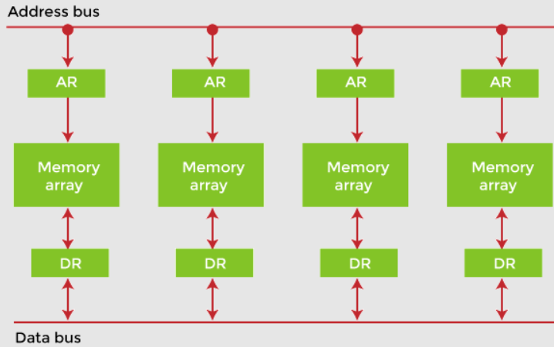
In memory interleaving organization a single large memory is divided into equal sized blocks called as memory modules (memory array).
These memory modules are equal in size.
The uniqueness of memory interleaving organization is assignment of two specific registers for each and every memory module
AR register
DR register.

Slide 5
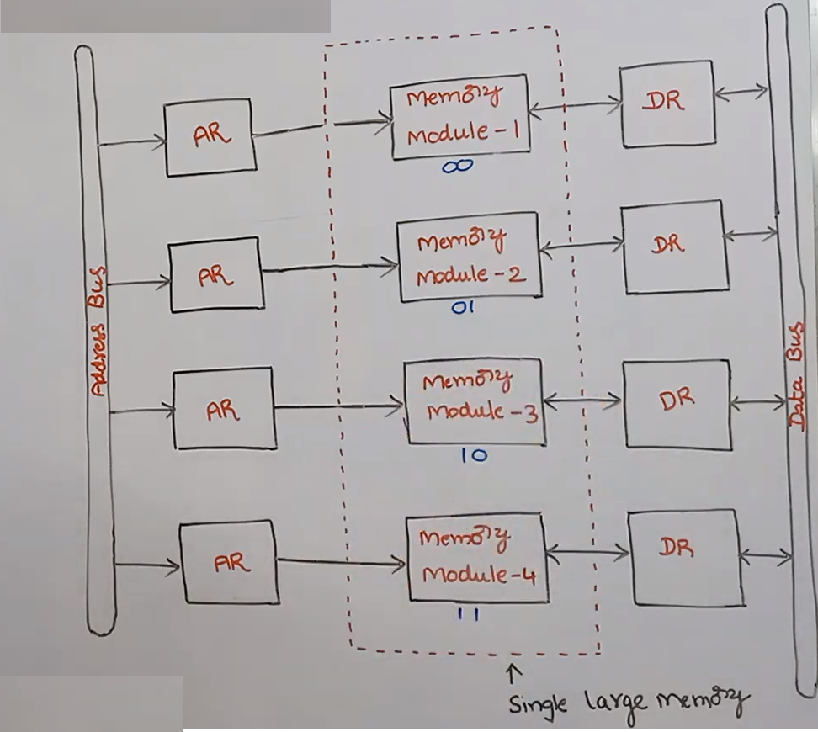
AR Register:
AR register stands for address register.
The address register can receive the data from the address bus which is common to all the memory modules here.
The address bus is common to four memory.
Address register contains only unidirectional because it receives the data from the address bus only modules
DR Register:
DR stands for data register.
The data register receives the data from the data bus which is connected to all the memory modules.
It can also send the data to the data-bus also because of that reason the data register has bi-directional communication.
The address register can receive the address from the address bus, so in that address for example so 0 0 1 0 is there this is the address that is received by the address register from the address bus
The LSB two bits specify the memory module.
That is 10, so it is memory module 3
The MSB two bits represent a specified memory location in the module.
That is 00 that in memory module 3, at 00 memory location.

Slide 6
Memory Interleaving : Introduction
Interleaved memory is technique designed to compensate for the relatively slow speed of dynamic random-access memory (DRAM) or core memory by spreading memory addresses evenly across memory banks.
Memory Interleaving is an abstraction technique.
Designed to compensate for core memory by spreading memory addresses evenly across memory banks.
Divides memory into a number of modules such that successive words in the address space are placed in the different module.
Parallel access is possible. Hence, faster.
Higher average utilization of the memory system.

Slide 7
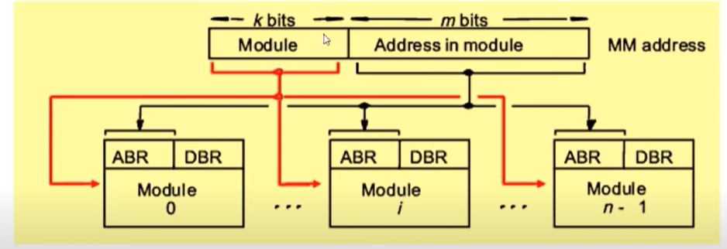
Memory Interleaving : Introduction
If the Main Memory is structured as collection of physically separate modules.
Each with it’s own Address Buffer Register (ABR) and Data Buffer Register (DBR), memory access operations.
It may proceed in more than one module at the same time.
Hence, aggregate rate of transmission of words to and from the memory can be increased.

Slide 8
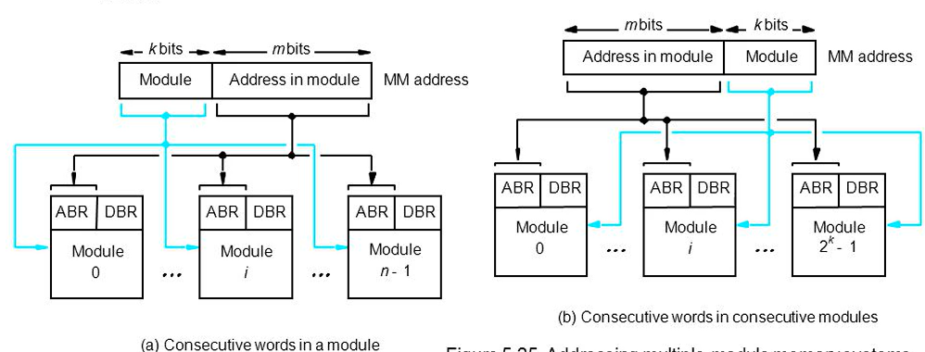
Distribution Methods in Memory system
Consecutive words in a module
Consecutive words in a Consecutive module
When consecutive locations are accessed, as happens when a block of data is transferred to a cache, only one module is involved
This method is called memory interleaving
Parallel access is possible. Hence, faster
Higher average utilization of the memory system

Slide 9
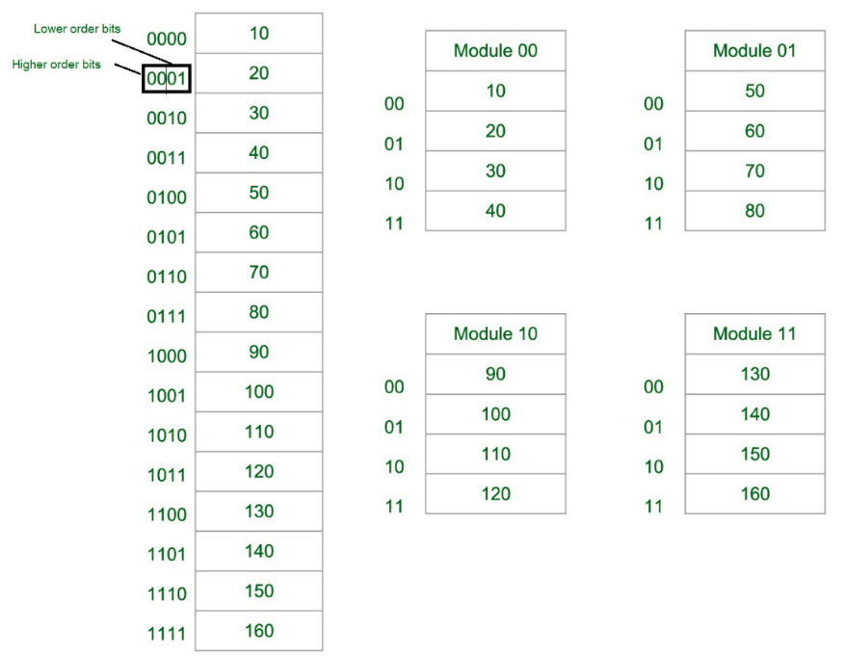
Distribution Methods in Memory system
Consecutive words in a module

Slide 10
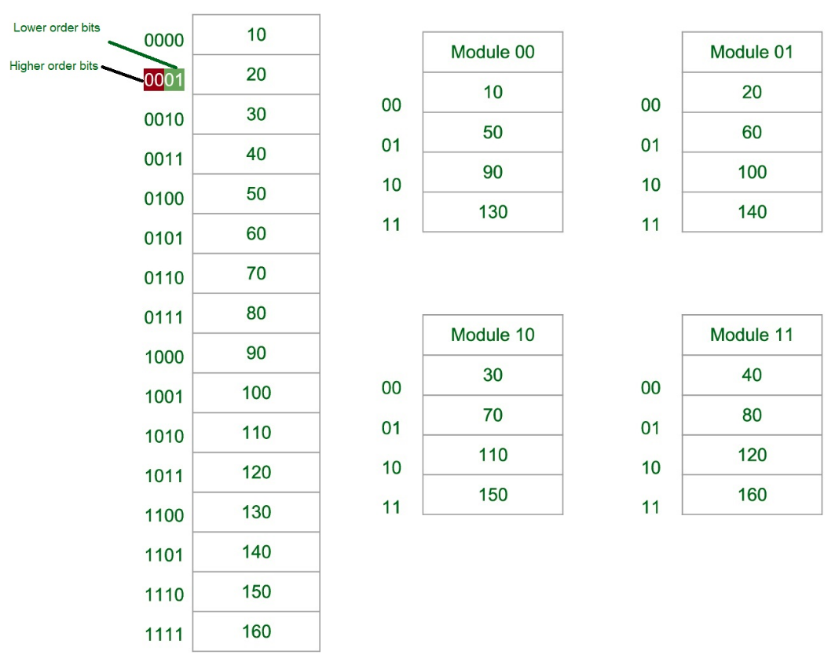
Distribution Methods in Memory system
Consecutive words in a Consecutive module

Slide 11
Reason to use of Memory Interleaving
Main memory is relatively slower than the cache.
So to improve the access time of the main memory, interleaving is used.
This method uses memory effectively.
Benefits of Memory Interleaving
It allows simultaneous access to different modules of memory.
Interleave memory is useful in the system with pipelining and vector processing.
In an interleaved memory, consecutive memory addresses are spread across different memory modules.
Reduce the memory access time by a factor close to the number of memory banks.

Slide 12
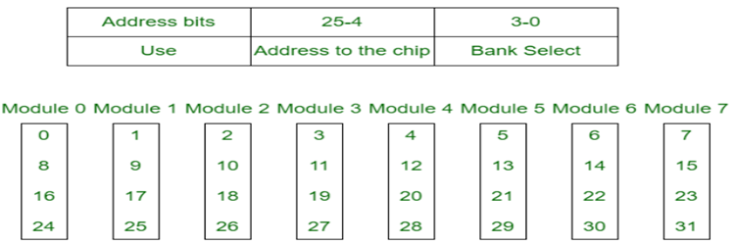
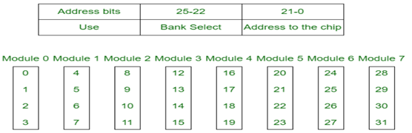
Memory Interleaving Types
Memory interleaving is classified into two types:
Low Order Interleaving
High Order Interleaving
In low-order interleaving, the least significant bits select the memory bank (module).
In this, consecutive memory addresses are in different memory modules.
This allows memory access at much faster rates than allowed by the cycle time.
In high-order interleaving, the most significant bits of the address select the memory chip.
The least significant bits are sent as addresses to each chip.
The maximum rate of data transfer is limited by the memory cycle time.

Slide 13
Interleaving DRAM
Main memory is usually composed of a collection of DRAM (Dynamic random-access memory) memory chips grouped together to form a memory bank.
The memory banks will be interleaved.
Memory accesses to different banks can proceed in parallel with high throughput.
Memory banks can be allocated a contiguous block of memory addresses, gives an equal performance and access gives far better performance in interleaved layouts.

Slide 14
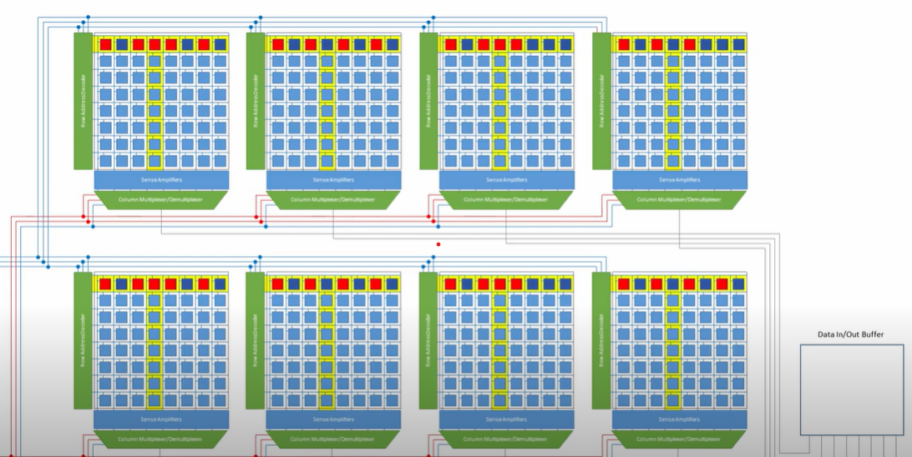
Interleaving DRAM

